Slide 1
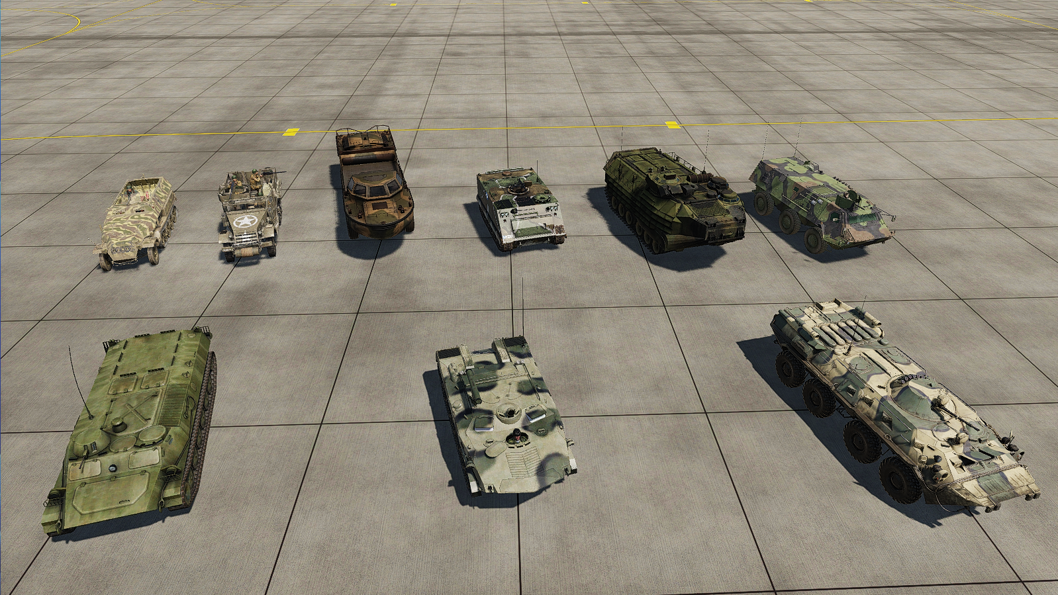
Armor → Armored personnel carrier
APC AAV7 Amphibious
APC M2A1 Halftrack
LARC-V
APC M-113
APC TPz Fuchs
APC Sd. Kfz 251 Halftrack
APC BTR-80
APC BTR-RD
APC MTLB
Older
Newer

Slide 2
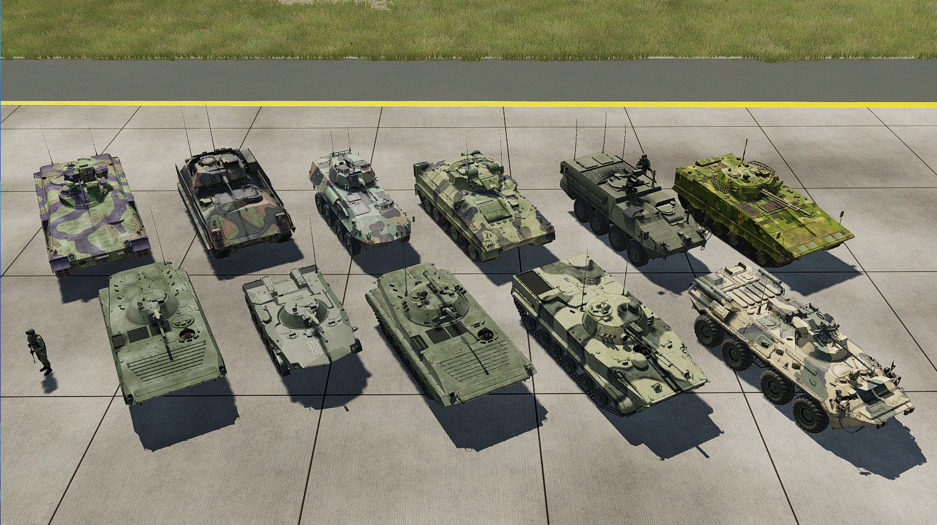
Armor → Infantry fighting vehicle
IFV M-2 Bradley
IFV LAV-25
IFV M1126 Stryker ICV
IFV Marder
IFV Warrior
ZBD-04A
IFV BMP-1
IFV BMD-1
IFV BMP-2
IFV BMP-3
IFV BTR-82A
Older
Newer

Slide 3
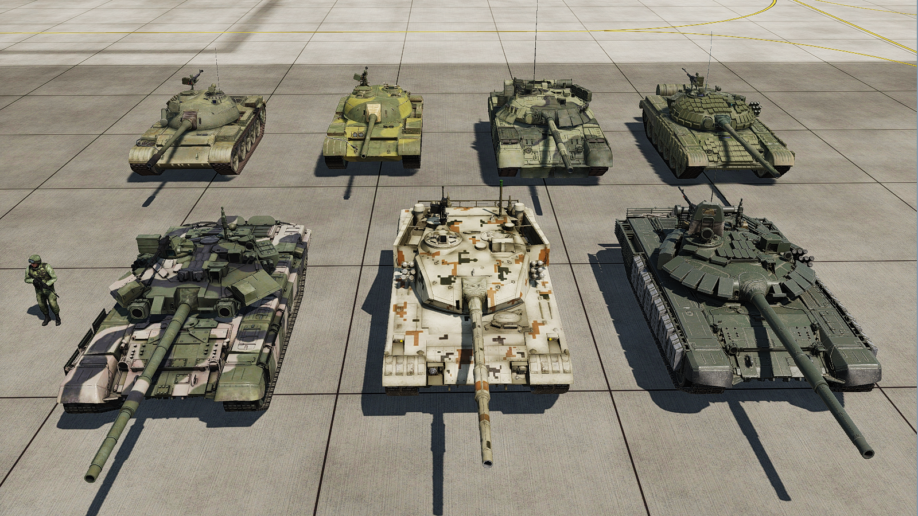
Armor → Main Battle Tank
MT Type 59
MTB T-80U
MTB T-72B
MTB T-55
MTB T-72-B3
MTB T-90
ZTZ-96B
Older
Newer

Slide 4
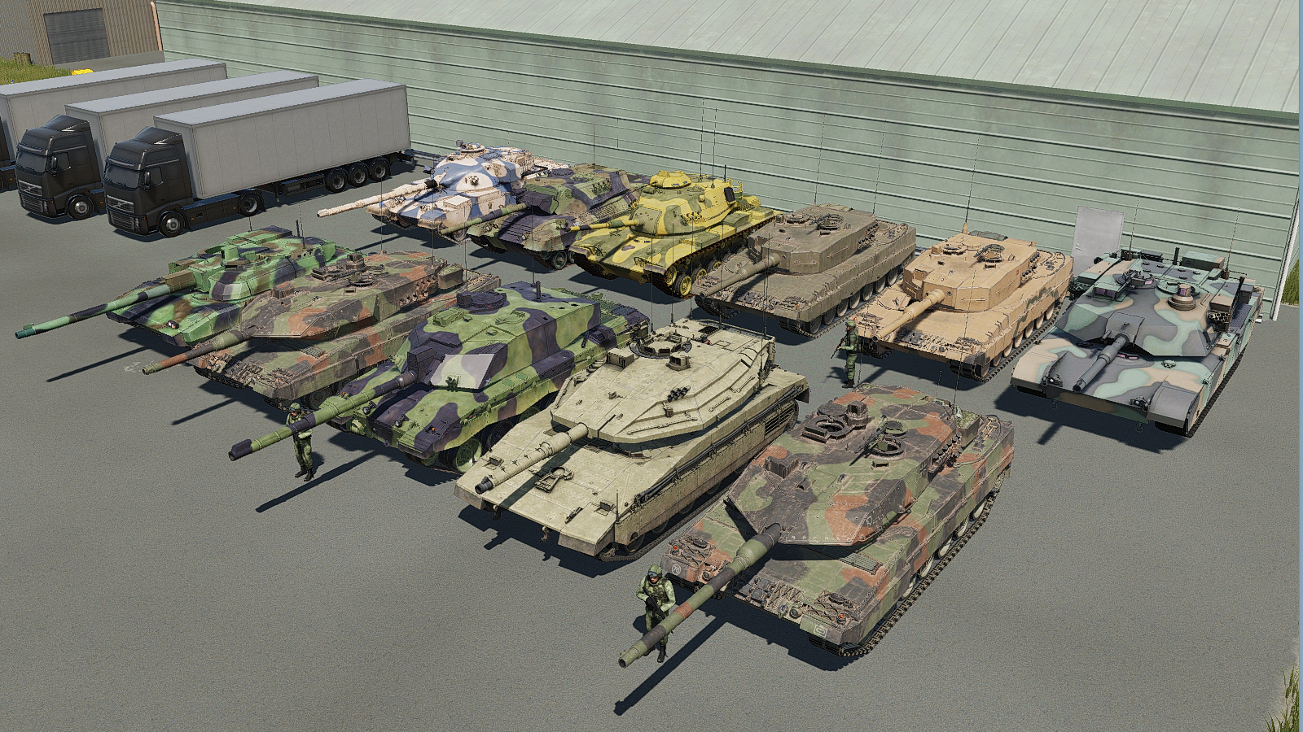
Armor → Main battle tank
MTB Chieftain MK.3
MTB Leopard 1A3
MTB M60A3 Patton
MTB Leopard 2A4
MTB Leclerc
MTB Leopard 2A4 Trs
MTB M1A2 Abrams
MTB Leopard 2A5
MTB Challenger II
Older
Newer
MTB Merkava IV
MTB Leopard 2A6M

Slide 5
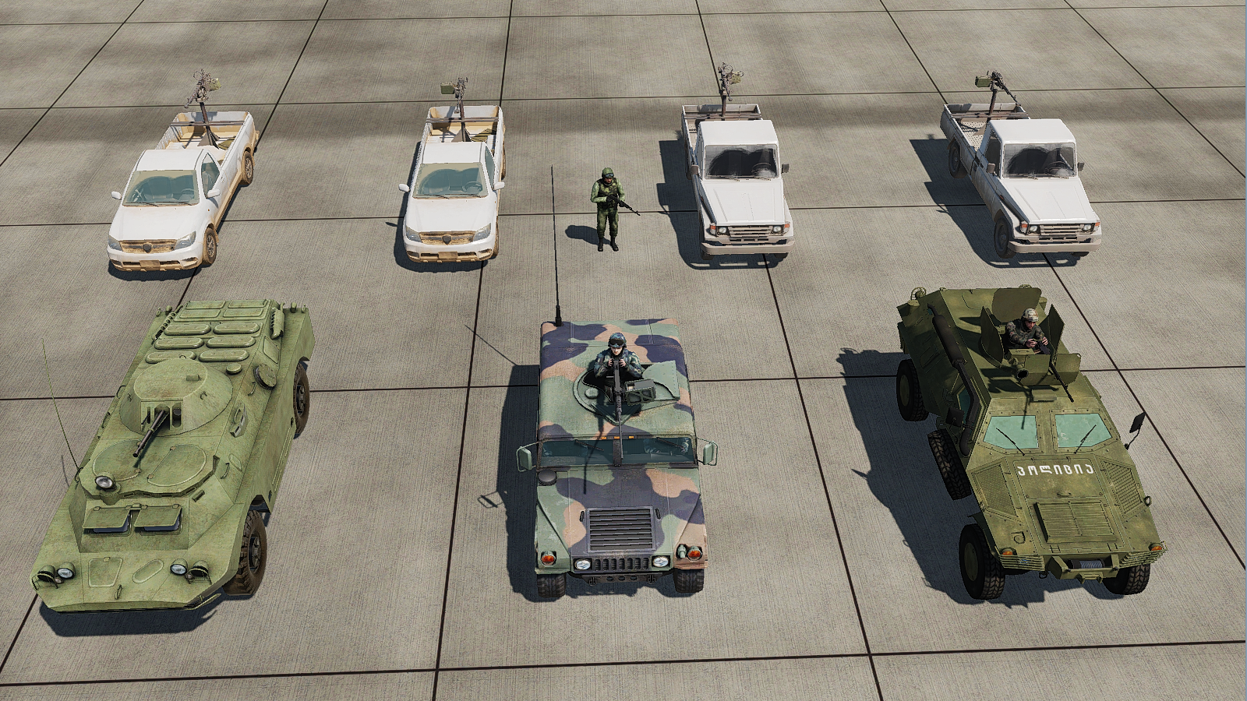
Armor → Scout & Recon
Scout HL with KORD 12.7mm
Scout LC with DSHK 12.7mm
Scout LC with KORD 12.7mm
Scout HL with DSHK 12.7mm
Scout Cobra
Scout BRDM-2
Scout HMMWV
Older
Newer

Slide 6
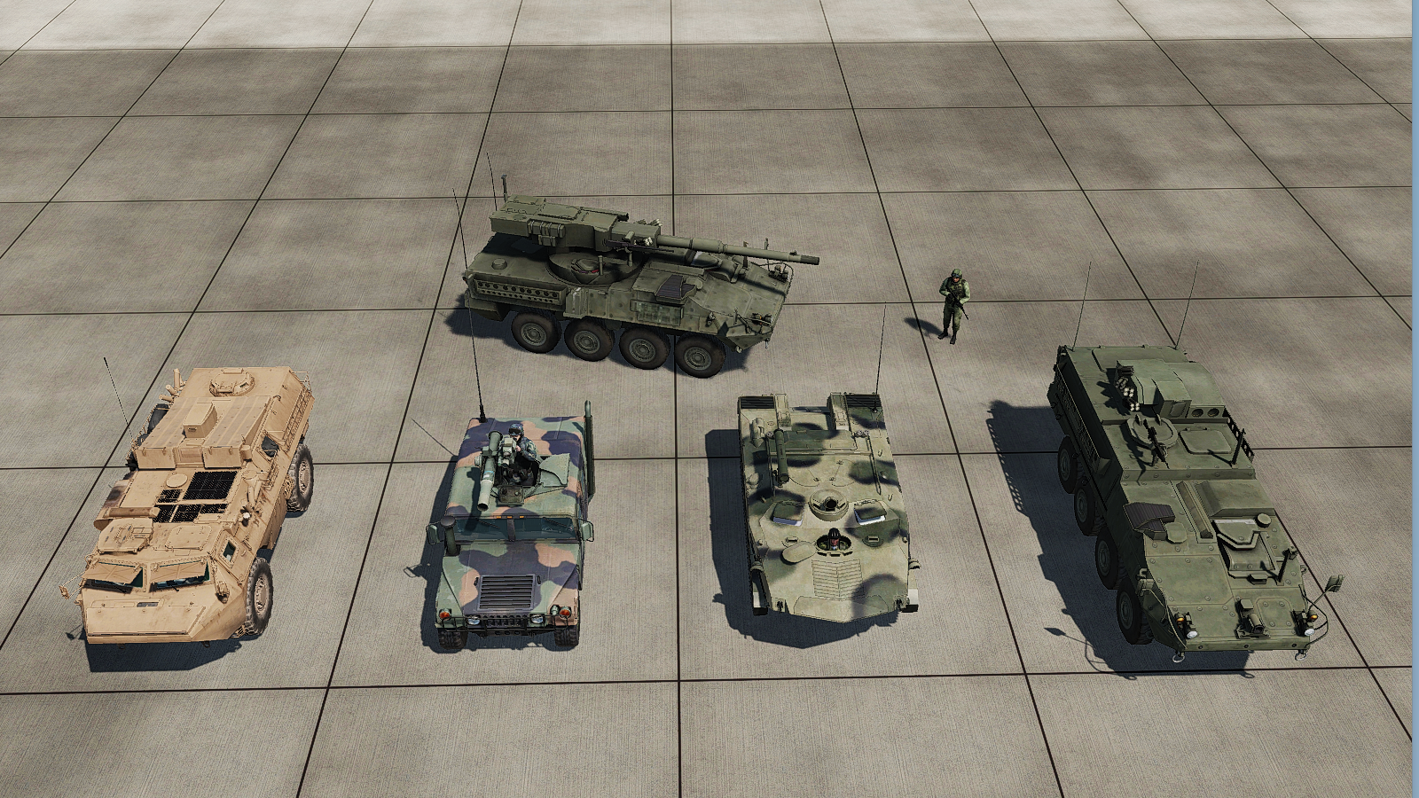
Armor → Self-Propelled ATGM
SPG Stryker MGS
*Self-Propelled Gun
ATGM Stryker
APC BTR-RD
ATGM VAB Mephisto
ATGM TOW
Older
Newer

Slide 7
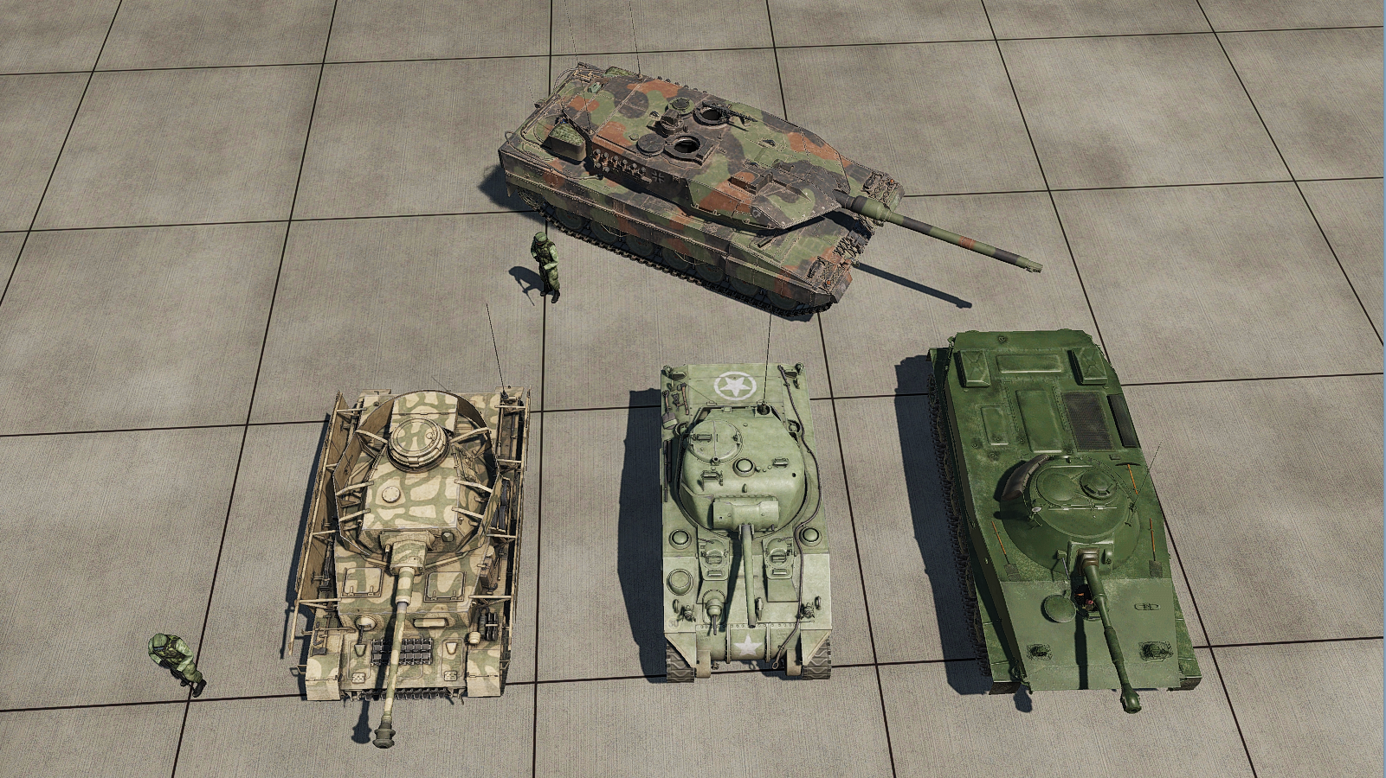
Armor → Tank
Tk PzIV H
LT PT-76
Tk M4 Sherman
Older
Newer

Slide 8
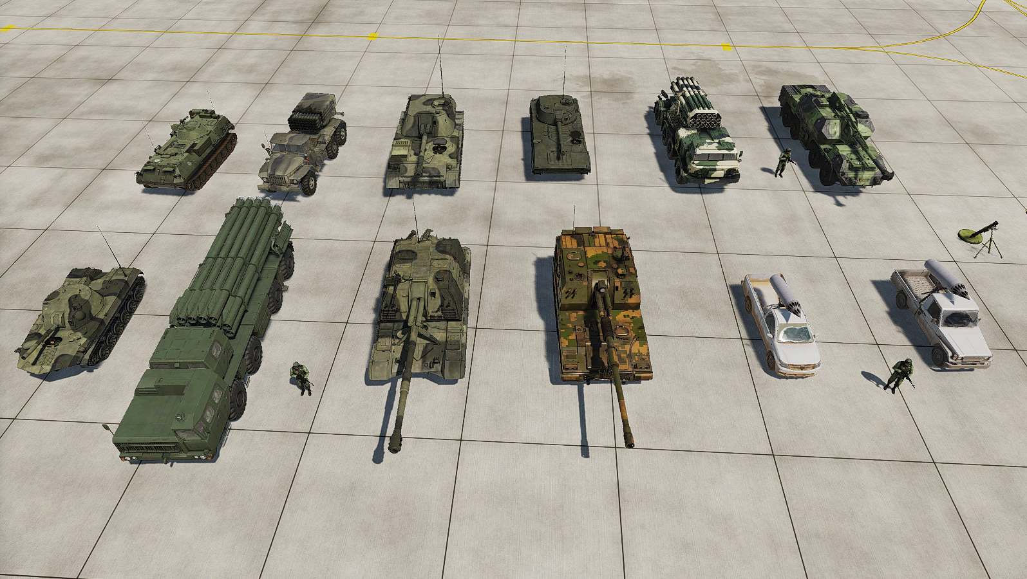
Artillery
MLRS BM-21 Grad
122 mm
SPH 2S3 Akatsia 152 mm
SPH 2S1 Gvozdika 122 mm
MLRS 9K57 Uragan BM-27 220 mm
Grad MRL FDDM (FC)
SPH Dana vz77 152mm
Mortar 2B11 120mm
PLZ-05
155mm
MLRS HL with B8M1 80mm
MLRS LC with B8M1 80mm
SPM 2S9 Nona 120 mm M
SPH 2S19 Msta 152mm
MLRS 9A52 Smerch HE 300mm
Older
Newer

Slide 9
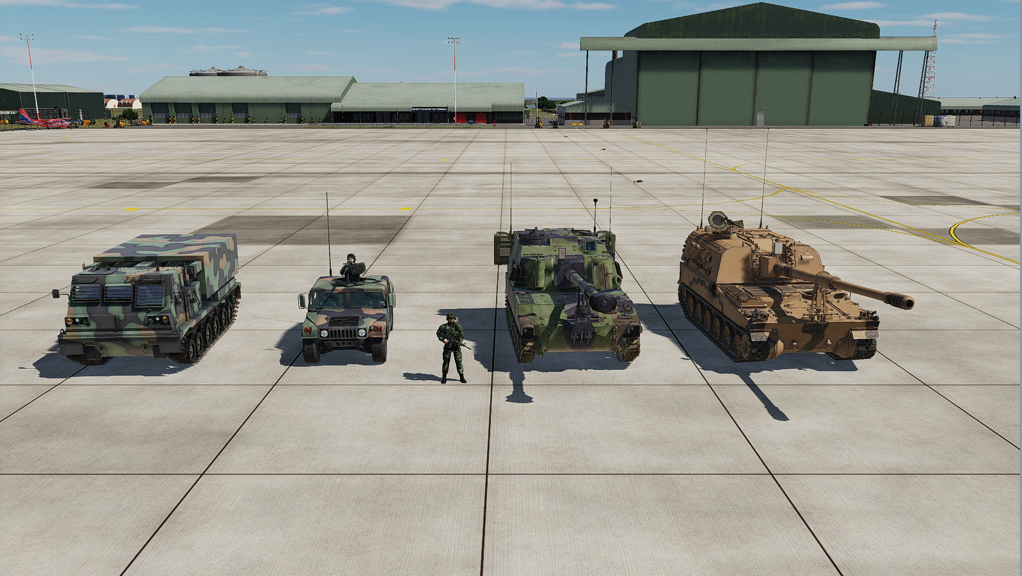
Artillery
SPH M109 Paladin
155mm
MLRS M270
227mm
SPH T155 Firtina
155mm
MRL FDDM (FC)
Older
Newer

Slide 10
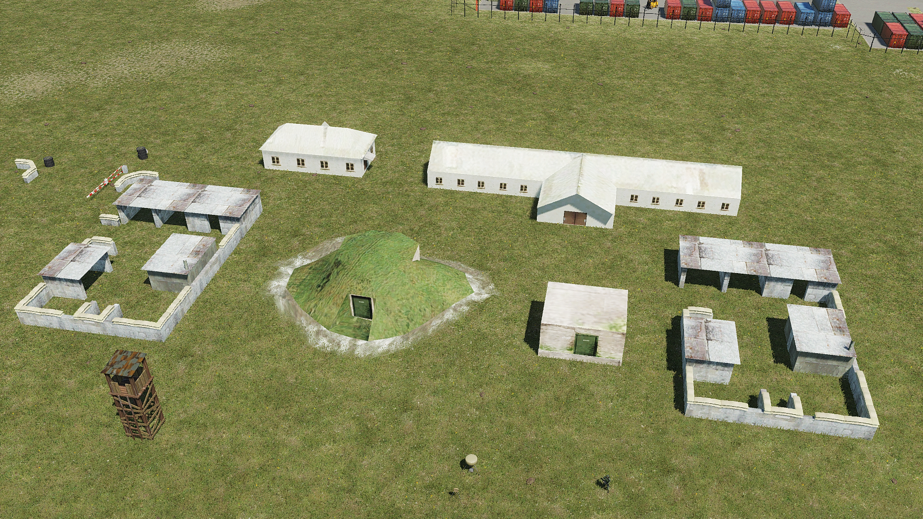
Fortification
Building armed *
Barracks armed *
Road outpost
Outpost
Beacon TACAN Portable TTS 3030
Watch tower armed *
Bunker 1
Bunker 2
* = Shoots back

Slide 11
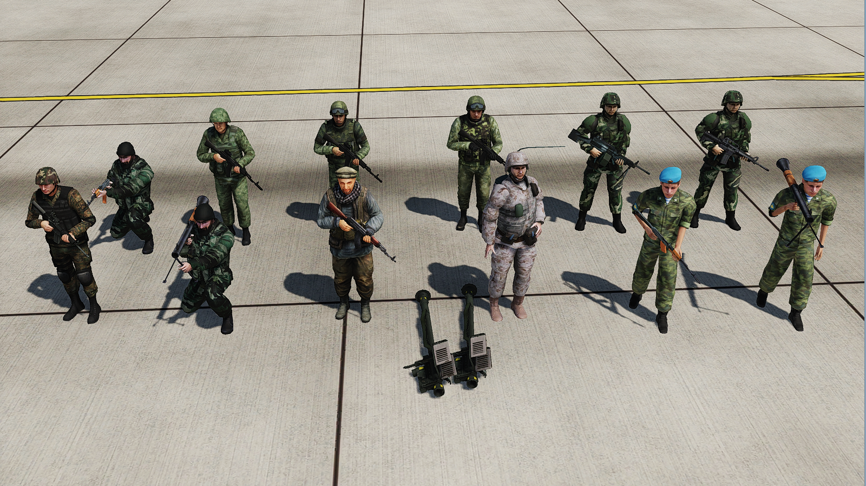

Infantry
Infantry M4
Infantry AK-74 Rus ver1
Infantry AK-74 Rus ver2
Infantry M249
Infantry AK-74 Rus ver3
Infantry AK-74
Insurgent AK-74
JTAC
(do not move)
Paratrooper RPG-16
Infantry M4 Georgia
Infantry RPG
Paratrooper AKS
= slides on ground
= choppy running
= realistic running and animated when still

Slide 12
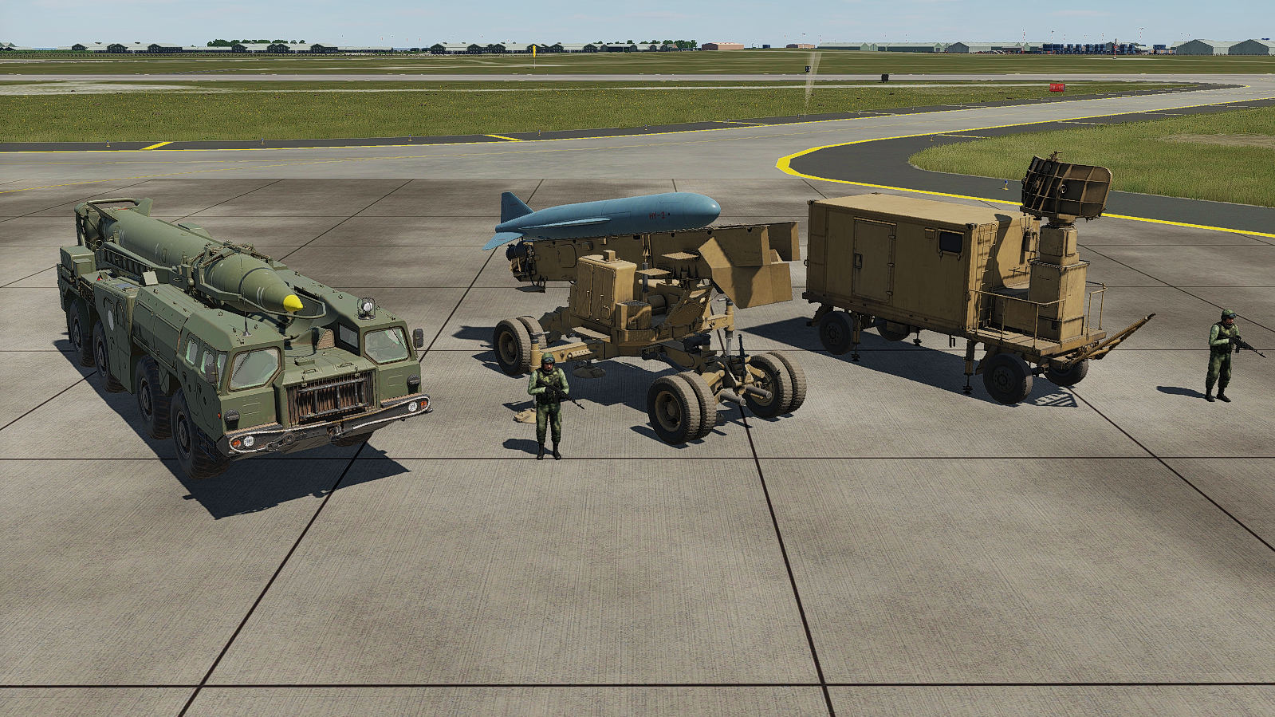
Missiles
AShM Silkworm SR
AShM SS-N-2 Silkworm
SRBM SS-1C Scud-B

Slide 13
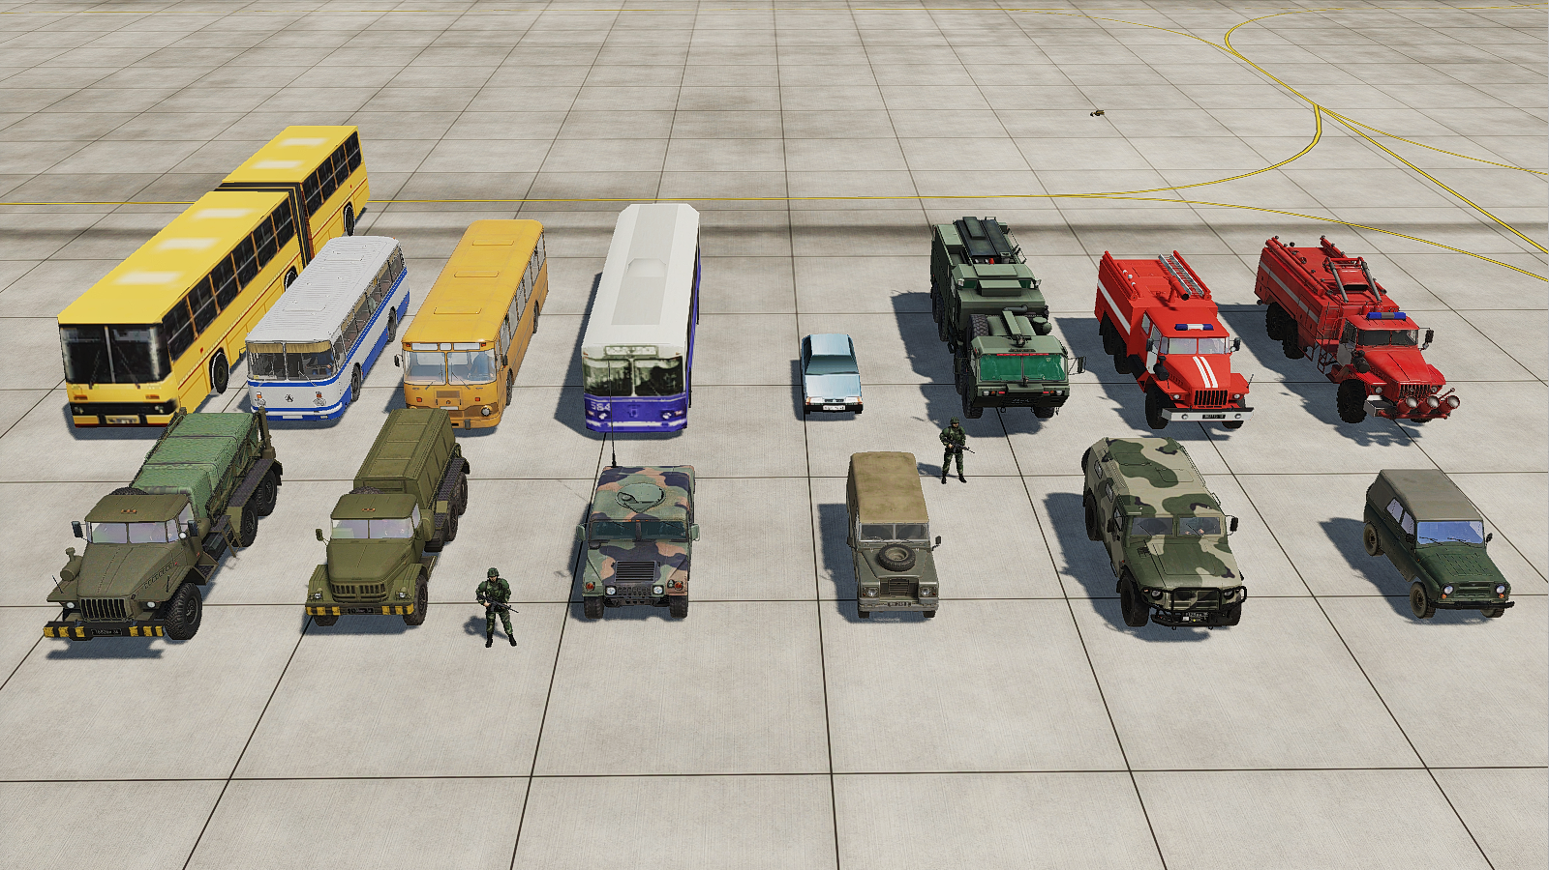
Unarmed → All
Firefighter HEMMT TFFT
Bus
LiAZ-677
Bus
ZIU-9 Trolley
Bus LAZ-695
Firefighter
Ural ATsP-6
Firefighter Vehicle AA-7.2/60
Bus IKARUS-280
Car
VAZ-2109
LUV HMMWV Jeep
LUV Land Rover
LUV
Tigr
LUV
UAZ-469 Jeep
GPU APA-5D on Ural 4320
GPU APA-80 on ZIL-131
= Low quality
= Medium quality
= High quality

Slide 14
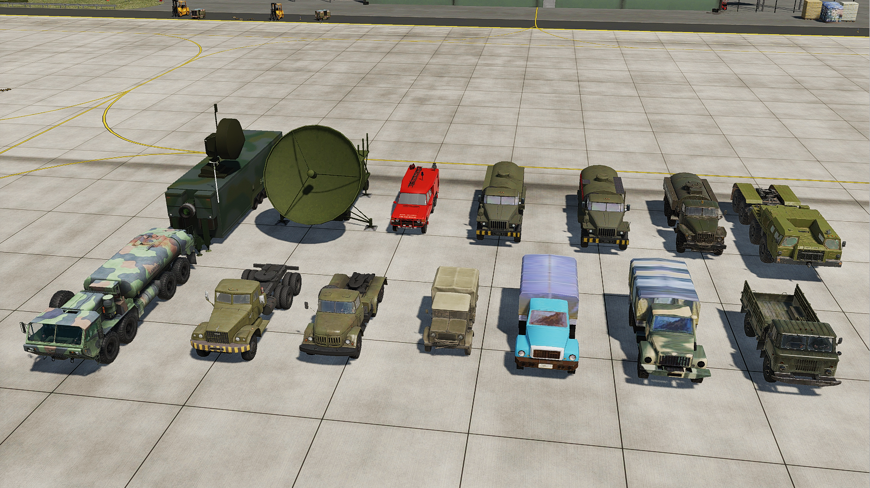
Unarmed → All
MCC-COMM Predator UAV CL
MCC Predator UAV CP & GCS
Refueler
ATMZ-5
Refueler
ATZ-10
Refueler
ATZ-5
RAF Rescue
Refueler
ATZ-60 Tractor
Refueler
M978 HEMTT
Refueler
TZ-22 Tractor
S-75 Tractor (ZIL-131)
Truck Bedford
Truck
GAZ-3307
Truck
GAZ-3308
Truck
GAZ-66
= Low quality
= Medium quality
= High quality

Slide 15
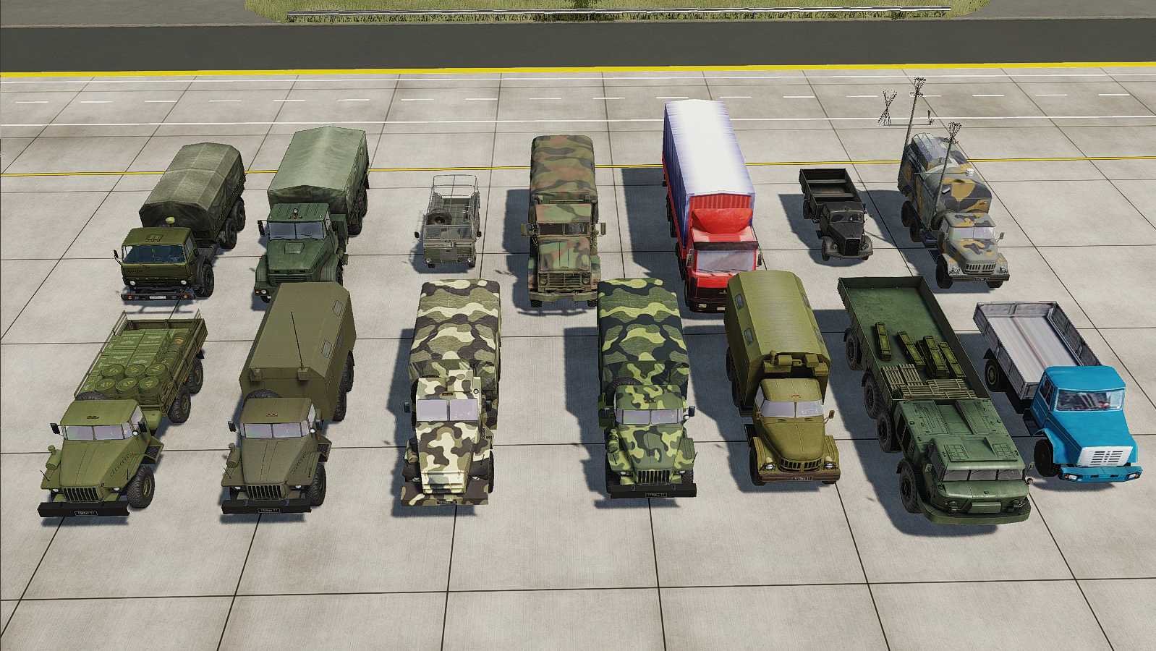
Unarmed → All
Truck
MAZ-6303
Truck
KrAZ-6322 6x6
Truck
M939 Heavy
Truck
Land Rover 101 FC
Truck
Opel Blitz
Truck
SKP-11
Mobile ATC
Truck
KAMAZ 43101
Truck Ural-4320T
Truck ZIL-131 (C2)
Truck
ZIL-4331
Truck
Ural-375
Mobile C2
Truck
Ural-4320-31 Arm’d
Truck
Ural-375
Truck
ZIL-135
= Low quality
= Medium quality
= High quality

